Slide 1
Predicting Lung Cancer using Machine Learning Models.
Frederick Asamoah
Enock Ackaah
Jing Sun
Yongqing Cai

Slide 2
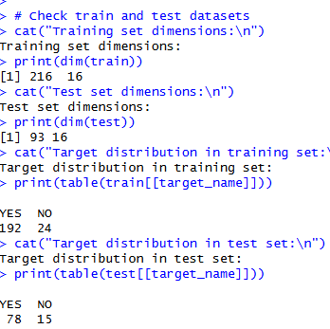
Description of Dataset & Data Preprocessing
CSV file: lung cancer.csv
Source: Kaggle dataset
Binary target variable (e.g., presence or absence of lung cancer)
Features: multiple clinical predictors (numerical/categorical)
Objective: Classification, Prediction

Slide 3
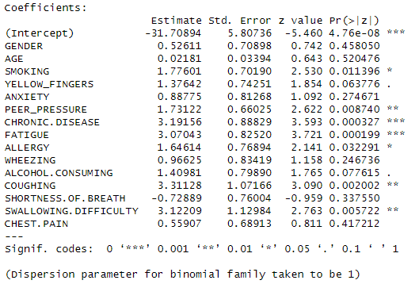
Description of Dataset & Data Preprocessing

Slide 4
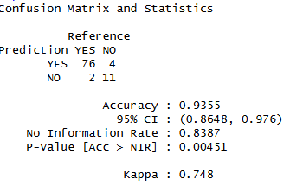
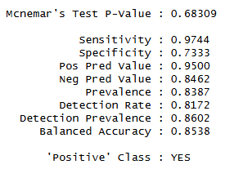


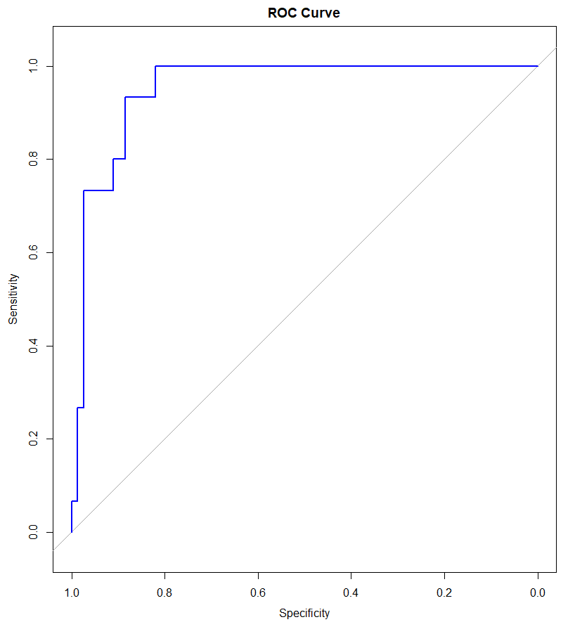
Logistic Regression Evaluation Metrics
RMSE: Measures prediction error (numeric)
AUC (Area Under ROC Curve): Measures model’s ability to discriminate
Confusion Matrix: Counts of True Positives
, True Negatives, False Positives, False Negatives

Slide 5
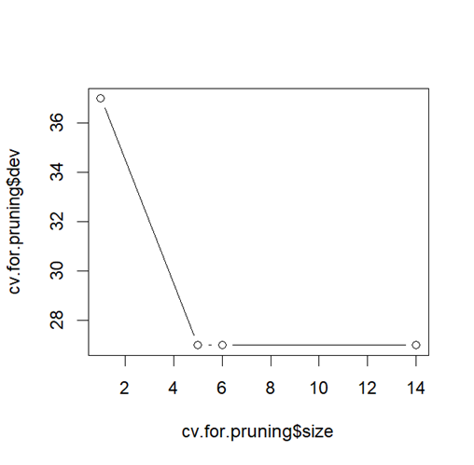
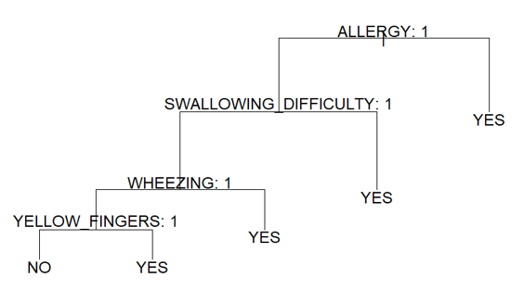
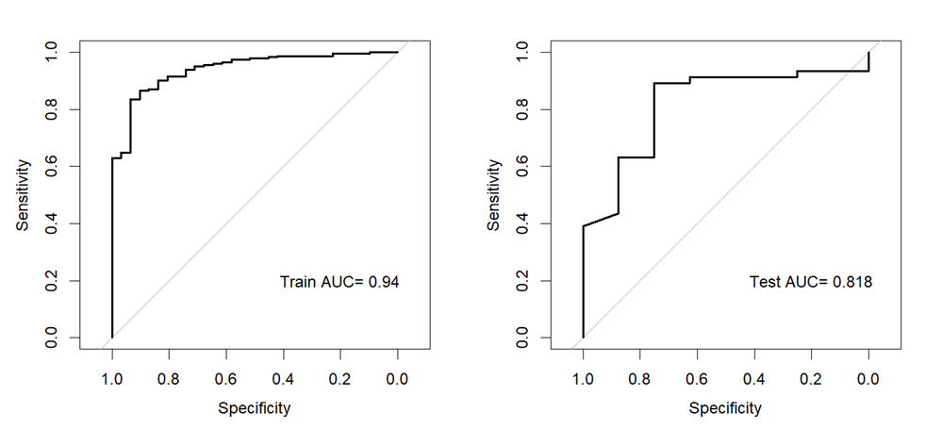
Decision Tree
Decision Tree for Lung Cancer dataset from Kaggel:
309 rows and 16 columns. Response: LUNG_CANCER, other 15 variables are predictors. Only AGE is numeric, other 14 are categorical.
Response: NO: 39, YES: 270 - Not balanced
Cross Validation:
number of folds: 5
number of obs: 309
Training data: 51 x 5 = 255
Test data: 54
 | Variables | Nodes | Residual mean variance | error rate
Test31 k=1 | 9 | 11 | 0.288 | 0.06863
Test32 k=2 | 9 | 13 | 0.2092 | 0.05882
Test33 k=3 | 10 | 13 | 0.2993 | 0.07353
Test34 k=4 | 9 | 11 | 0.2155 | 0.04902
Test35 k=5 | 8 | 12 | 0.2579 | 0.05882
Grow and prune, best nodes no. is 5.
Bagging

Slide 6
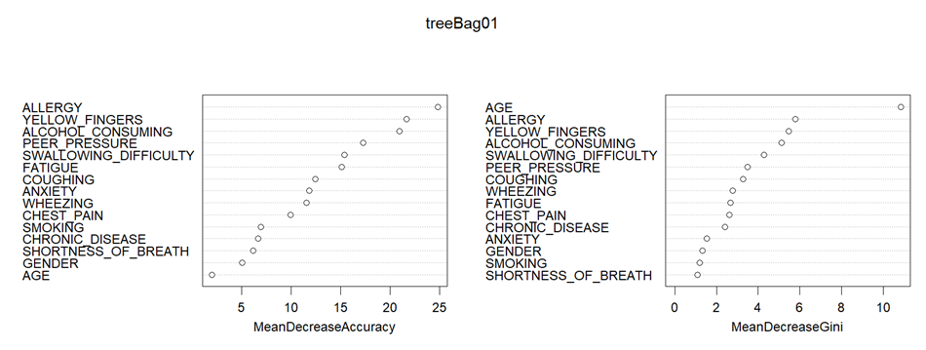
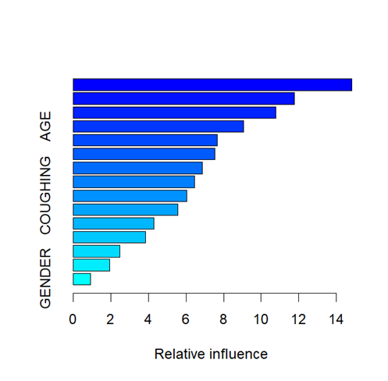
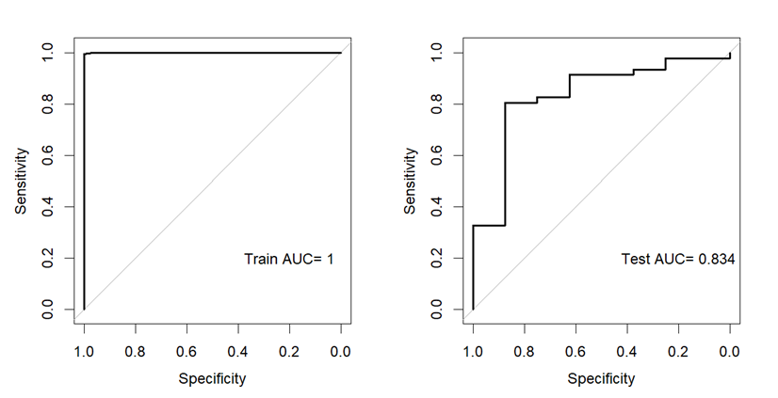
Decision Tree
summary(tree boosting)
var rel.inf
YELLOW_FINGERS YELLOW_FINGERS 14.8266516
FATIGUE FATIGUE 11.7569655
ANXIETY ANXIETY 10.7888451
Summary of Train AUC and Test AUC
> LogiReg
[1] 0.9823589 0.8777174
> GrowAndPrune
[1] 0.8464862 0.8288043
> Bagging
[1] 0.9398041 0.8179348
> RandomForest
[1] 0.9394441 0.8084239
> Boosting
[1] 0.9999280 0.8342391
Train
Reference
Prediction NO YES
NO 25 4
YES 6 220
Boosting
Test
Reference
Prediction NO YES
NO 5 3
YES 3 43
Logistic regression and decision tree with boosting have better AUCs.

Slide 7
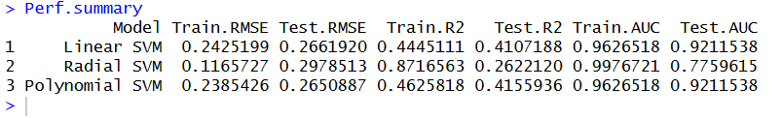
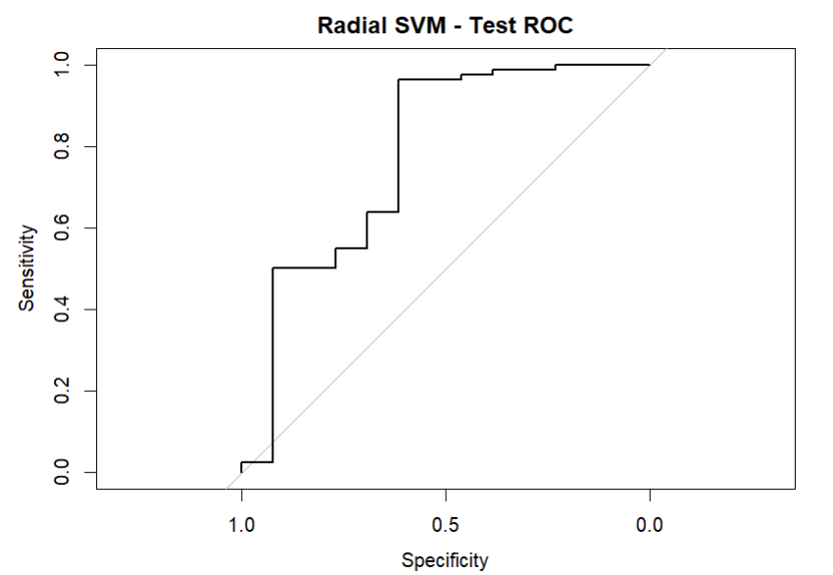
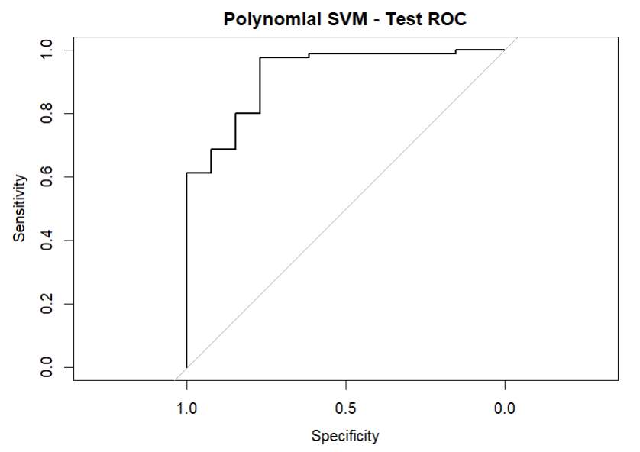
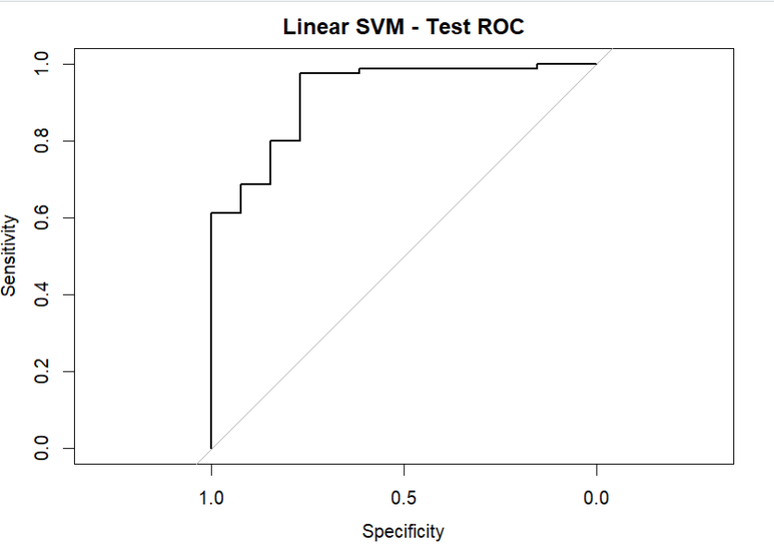
SVM Analysis Summary
Evaluated SVM with linear, radial (RBF), and polynomial kernels
Dataset prepared by removing categorical variables and scaling numeric predictors
Response variable (LUNG_CANCER) encoded as binary factor
Train-test split: 70% training, 30% testing
Hyperparameters tuned using 5-fold cross-validation
Conclusion : Based on the performance metrics and ROC curves
Linear SVM performed best overall, with strong Test AUC (~0.92) and stable metrics
Polynomial SVM showed similar AUC, but slightly higher error
Radial SVM performed weakest, with lower Test AUC (~0.78).
Linear SVM is the most reliable model for this dataset.

Slide 8
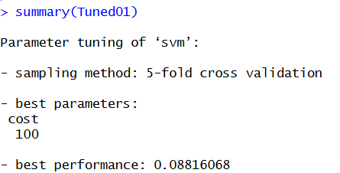
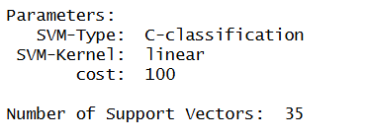


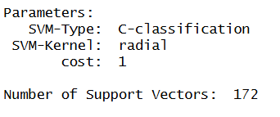
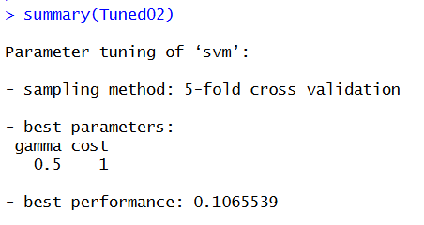
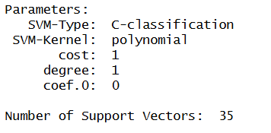
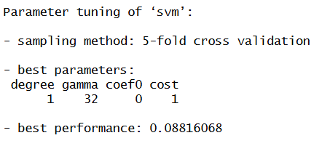

Key Model Settings and Confusion Matrix
The linear kernel performed strongly with excellent generalization.
Radial Kernel performed weakest, with lower
Polynomial SVM showed similar AUC, but slightly higher error

Slide 9

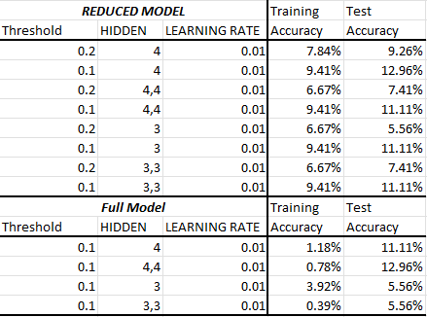
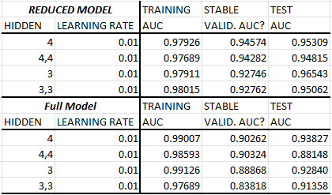
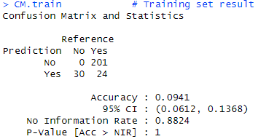
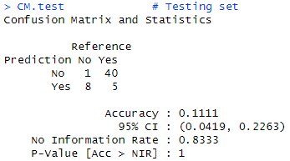
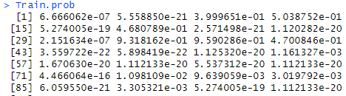
Neural Network
Package used: neuralnet

Slide 10
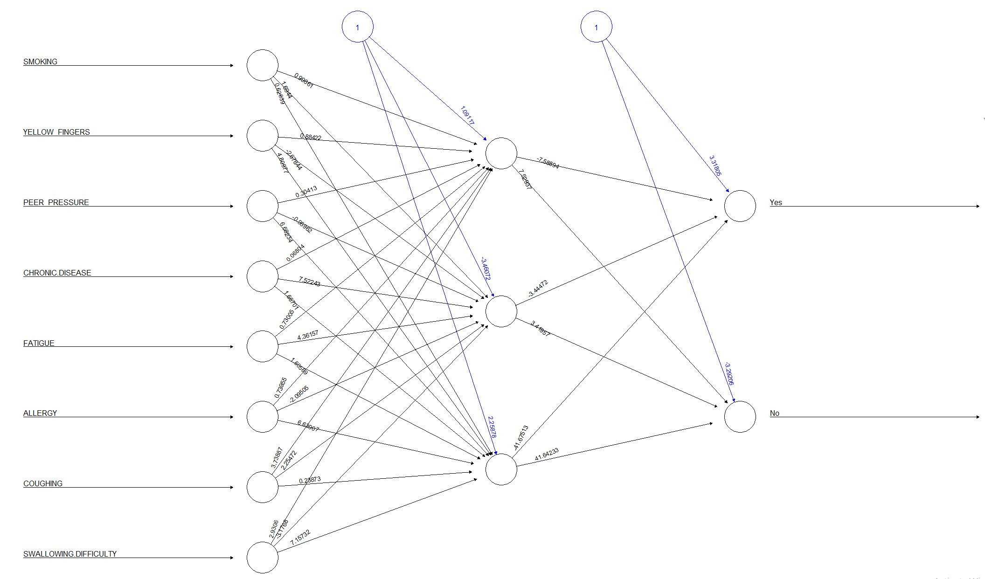
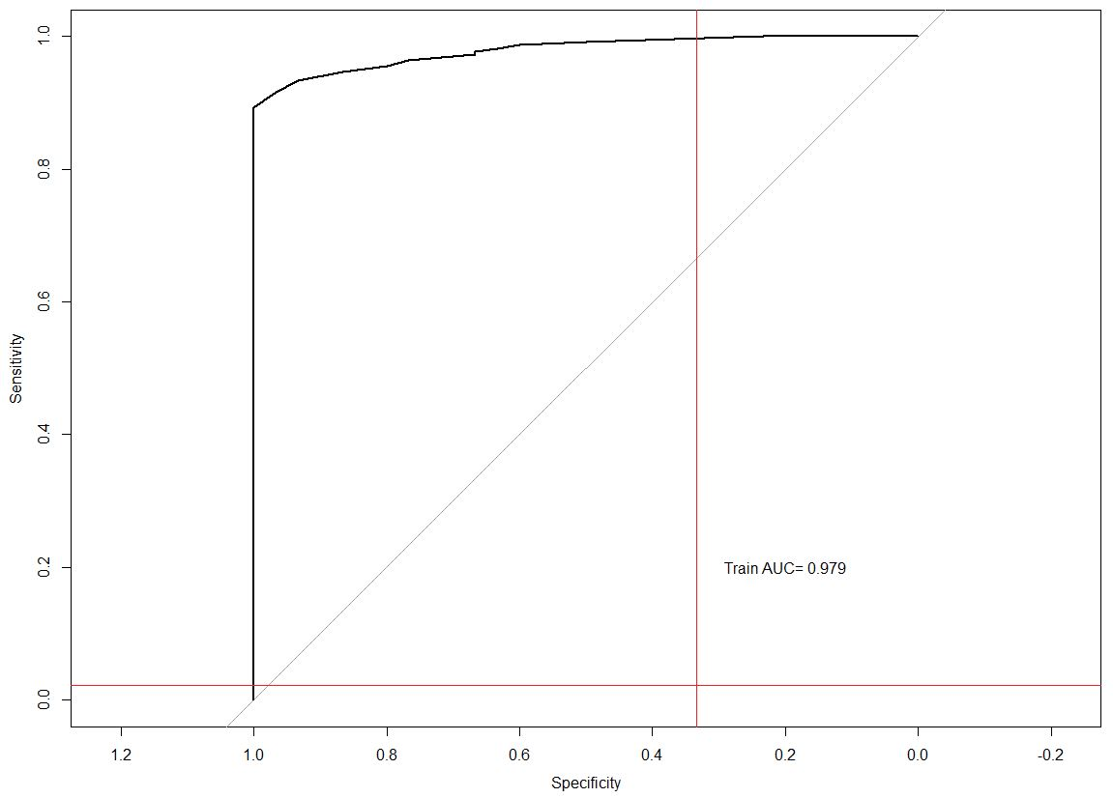
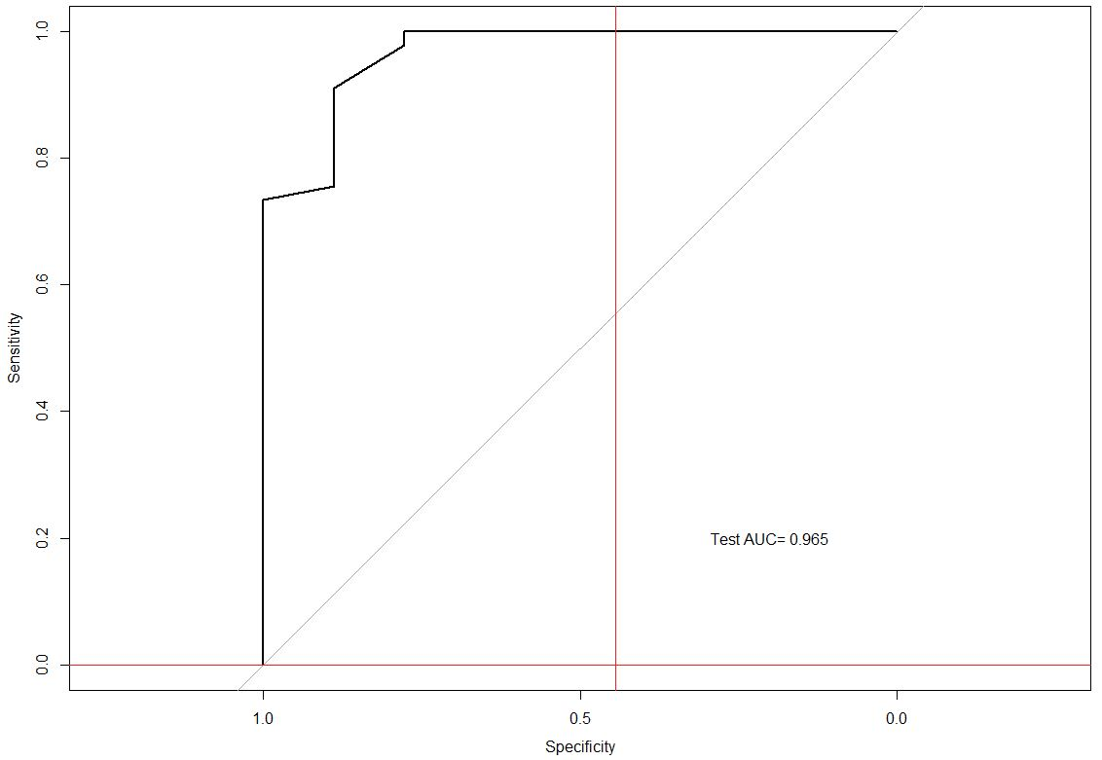
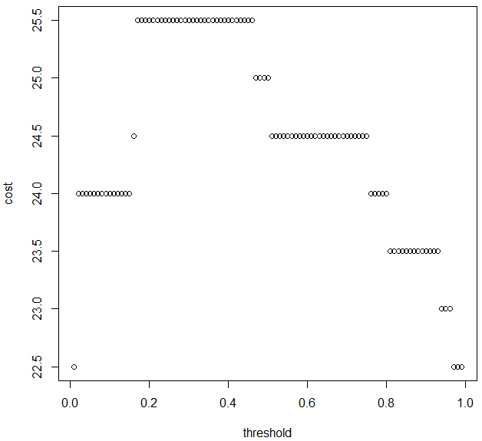
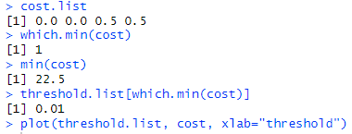
Neural Network

Slide 11
Conclusion
Base Model: Logistic Regression: Test AUC = 0.87772
Decision Tree Model: Boosting: Test AUC = 0.83424
SVM Model: Linear SVM: Test AUC = 0.92115
NN Model: 1 hidden layer with 3 nodes: Test AUC = 0.96543
SVM Linear Model has a high Test set AUC and better classification accuracy, thus this is the best model for our Lung cancer prediction project.

